Slide 1

Gender Classification Data Analysis Report
Prepared by
Doolayefa Erenah
Doolayefaerenah1367@gmail.com
March 27th ,2024

Slide 2
Table Of Content
Introduction………………………………………………………..3
3.1 Purpose of this Analysis……………………………..3
3.1 Brief Dataset description………………….…………3
Methodology……………………………………………………....4
4.1 Read Dataset………………………………………….….4
Results………………………………………………………………..5
5.1 Figure 1…………………………………………………….5
6.1 Figure 2…………………………………………………….6
7.1 Figure 3…………………………………………………….7
8.1 Figure 4…………………………………………………….8
9.1 Figure 5…………………………………………………….9
10.1 Figure 6………………………………………………….10
11,1 Figure 7………………………………………………….11
12.1 Figure 8………………………………………………….12
13.1 Figure 9………………………………………………….13
Discussions……………………………………………………..….17
Conclusions………………………………………..……………...18

Slide 3
INTRODUCTION
Purpose Of This Analysis:
The purpose of this analysis is to create a model that can predict the gender of a person based
on their facial features.
Brief Dataset Description:
Gender classification is an essential task in the field of computer vision that has gained
significant attention in recent years. There are various factors that can be used to differentiate
between male and female faces, such as long hair, forehead width and height, nose width and
length, lips thinness, and the distance between the nose and lips. The dataset contains a total
5001 people, each labeled as male or female.

Slide 4
METHODOLOGY
I downloaded the dataset titled Gender classification from Kaggle, and for the entire
analysis I used jupyter notebook that has python libraries. I did a little data cleaning by
converting “Gender” from a string to an integer so that it would be accepted by the model,
whereby 1 =Male and 0 =Female. I then moved on to the dataset analysis and visualizations
by first importing the necessary libraries such as numpy, pandas, matplotlib and seaborn.
I went ahead to split the data into training and testing sets for model evaluation.
Read Dataset
Before performing any data analysis I first read the data into a data frame and this was
done using the pandas read_csv function. I moved on to check the data frame using the
Head method to access the first few rows to confirm that it has the right type of data.

Slide 5
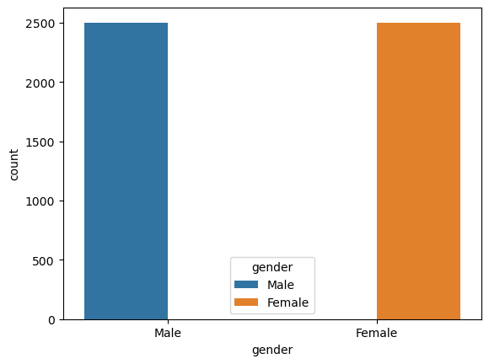
RESULTS
Figure 1
This shows that the dataset contains 2501 females and 2500 males .
Where 1=Male and 0=Female

Slide 6
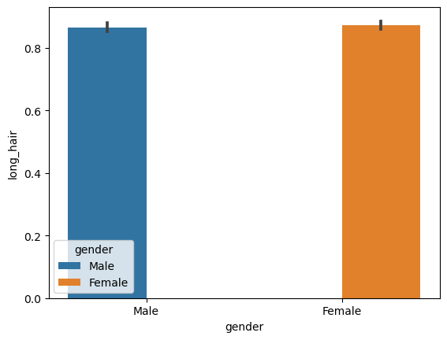
Figure 2
Female hair is slightly longer than the male hair.

Slide 7
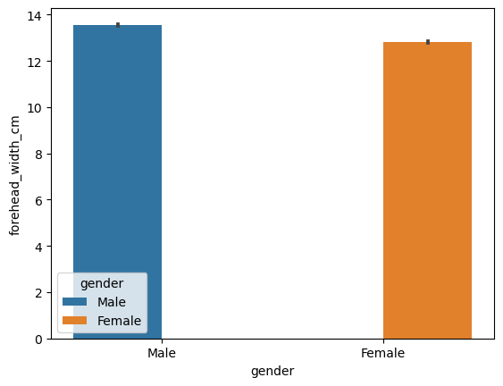
Figure 3
More males from this dataset have wider foreheads.

Slide 8

Figure 4
More males from the dataset have longer foreheads.

Slide 9
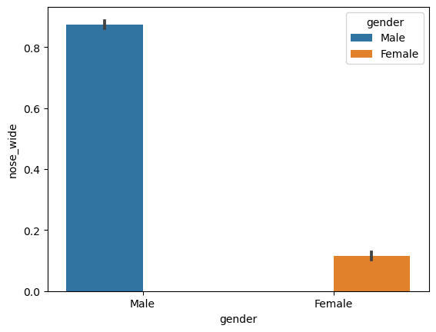
Figure 5
Greater number of men from the dataset have wider nose

Slide 10
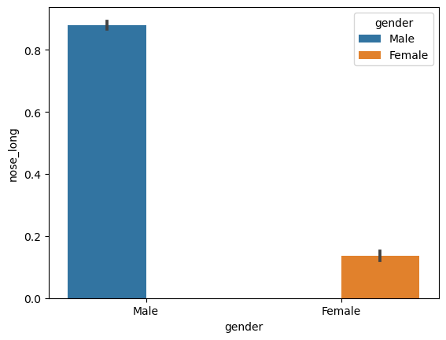
Figure 6
Greater number of men from this dataset have longer nose than females.

Slide 11
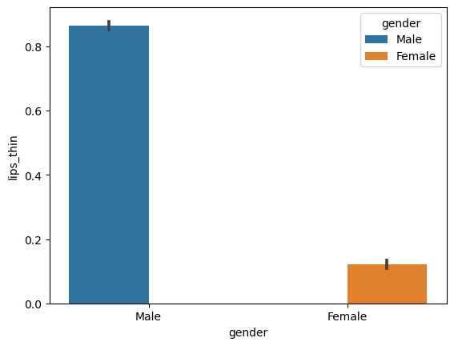
Figure7
A greater number of males have thinner lips than females.

Slide 12
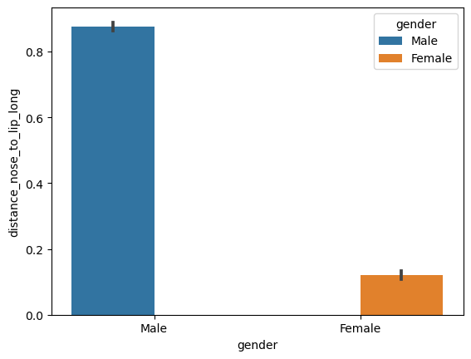
Figure 8

Slide 13
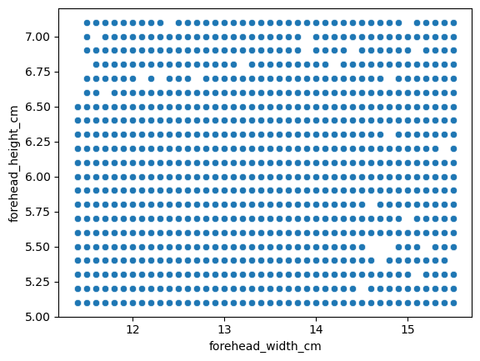
Figure 9
# There is no linear relationship between this 2 variables. So there’s no correlation

Slide 14
Discussion
Creating a gender classification model using a dataset with features such as long_hair,
forehead_width, forehead_height, nose_width, nose_length, lips_thin, and distance_nose_
lip can be a very useful tool for various applications such as social media and dating apps,
And can also boost the performance of many other applications including face recognition. By
using a machine learning algorithm, i created a model for gender classification.

Slide 15
Conclusion
In this article I have discussed how I used python to build a gender classification model. We
have also trained and tested the model. This article is just a starting point, there are many
other ways to build a gender classification model. You can also experiment with different
techniques and parameters to improve the accuracy of the model.

